Slide 1
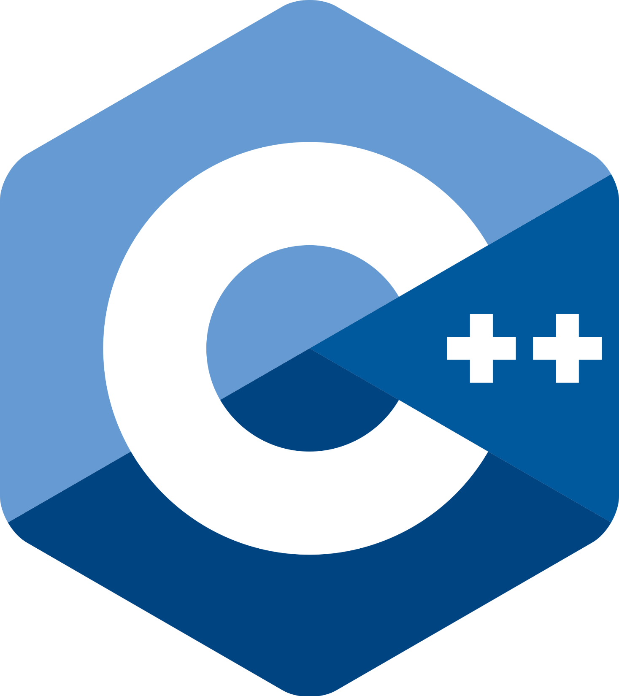

Slide 2
Overview
A high level programming language.
An enhancement to C language, which means we can use C functions in C++ IDE’s.
We will learn the things we will use in competitive programming.

Slide 3
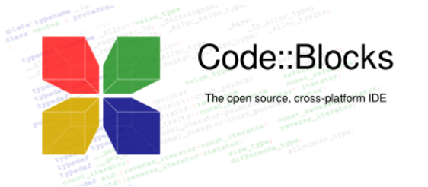
Where to code C++ ?
Code blocks
You can also use online IDE’s like Ideone and csacademy workspace.
You can also use a simple text editor like SublimeText and also the command line as we will see in the first week.

Slide 4
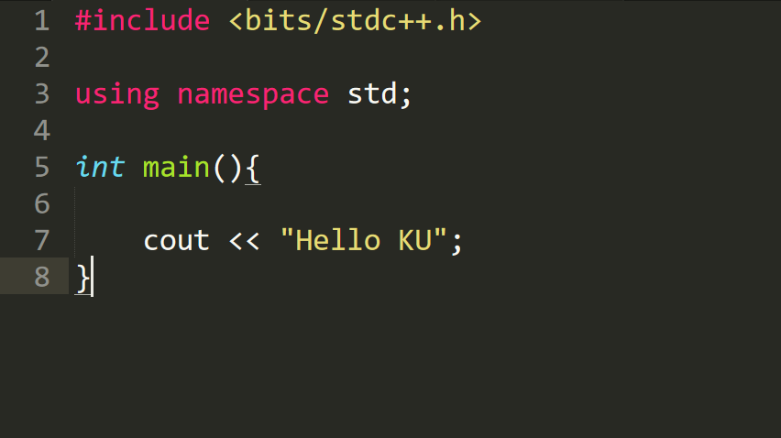
Template

Slide 5
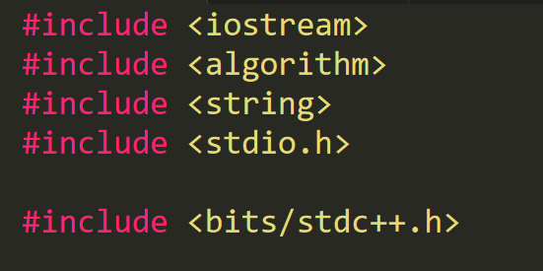
Libraries

Slide 6
Variables
Locations in the memory that store values.
Each variable has a name and a value.
The name of the variable should not be a reserved word in C++.
Can be thought of as box with labels outside and values inside them, and we can access the value using the name of the box.

Slide 7
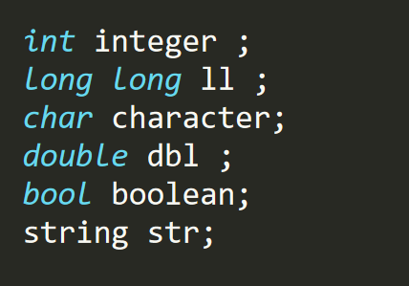
Types of Variables

Slide 8
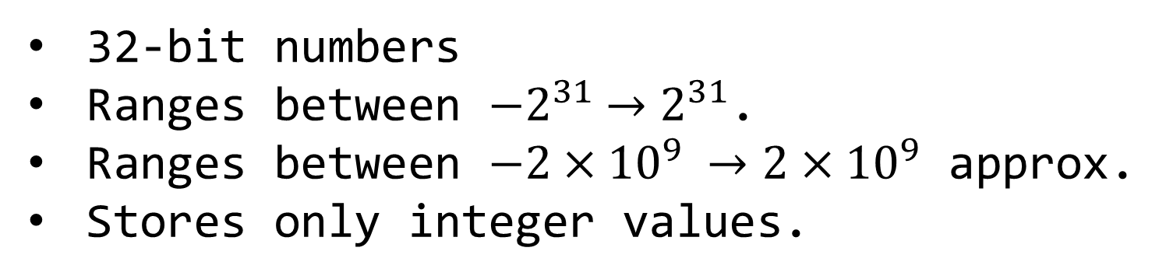
int
32-bit numbers
Ranges between ${−2}^{31} →2^{31}$.
Ranges between $−2×{10}^{9} →2×{10}^{9}$ approx.
Stores only integer values.

Slide 9
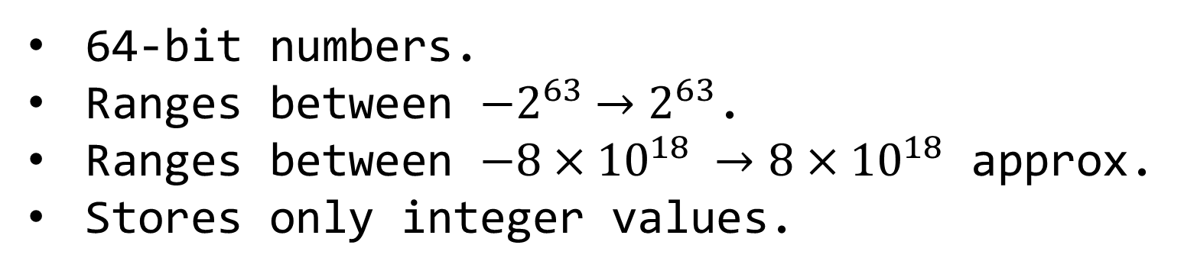
long long
64-bit numbers.
Ranges between ${−2}^{63} →2^{63}$.
Ranges between $−8×{10}^{18} →8×{10}^{18}$ approx.
Stores only integer values.

Slide 10
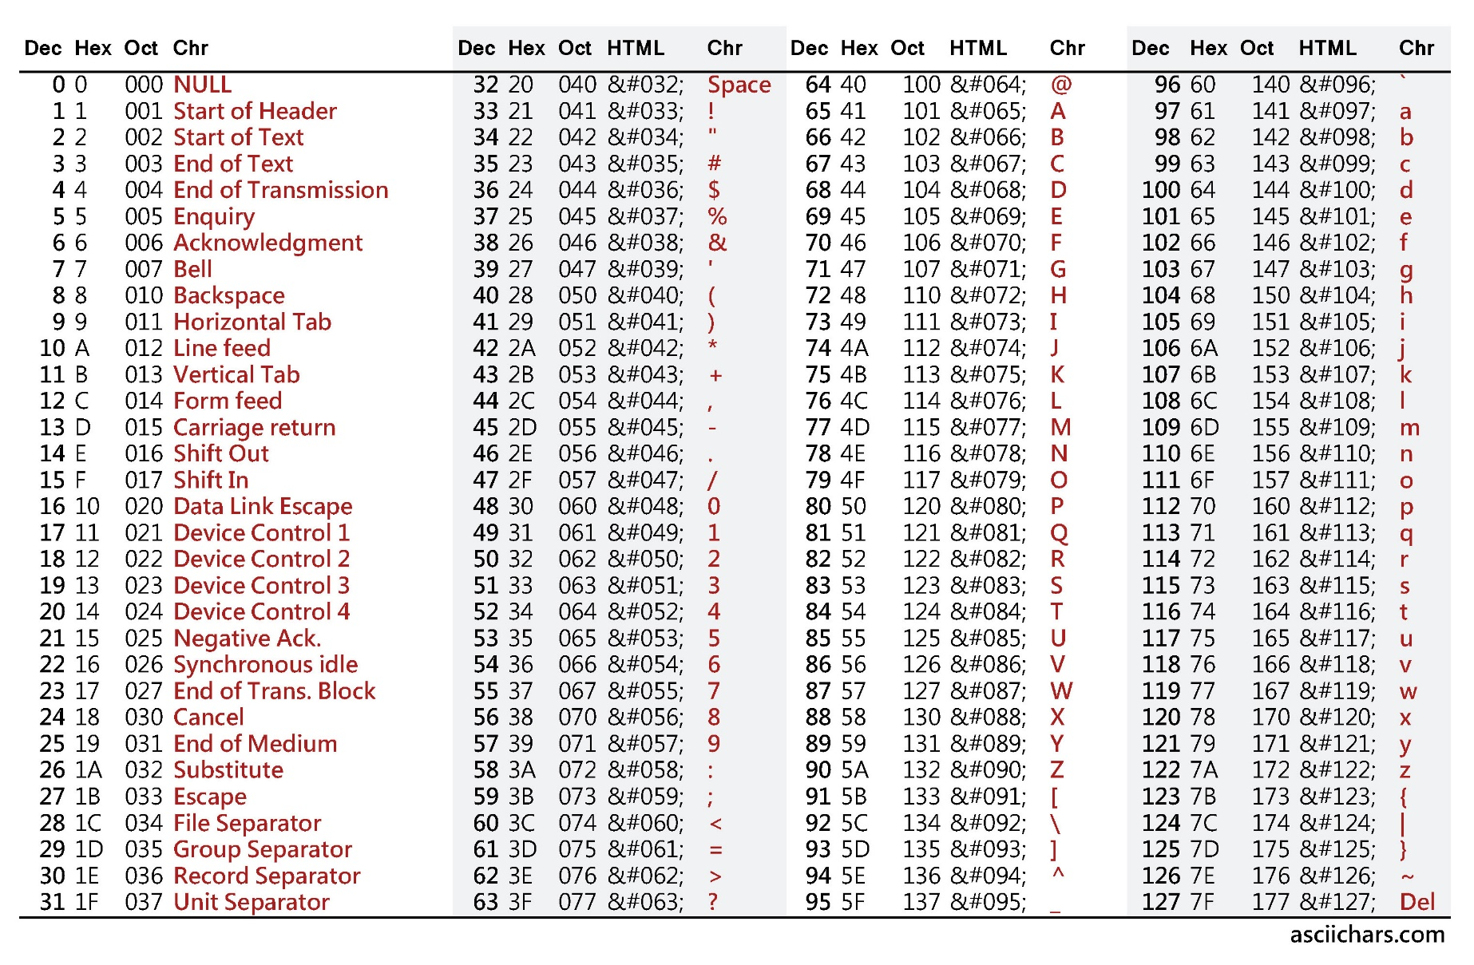
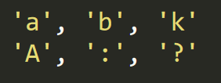
char
Can store any of the symbols in the ASCII chart.
Characters
  should be
  written in
  a single
  quote like:

Slide 11
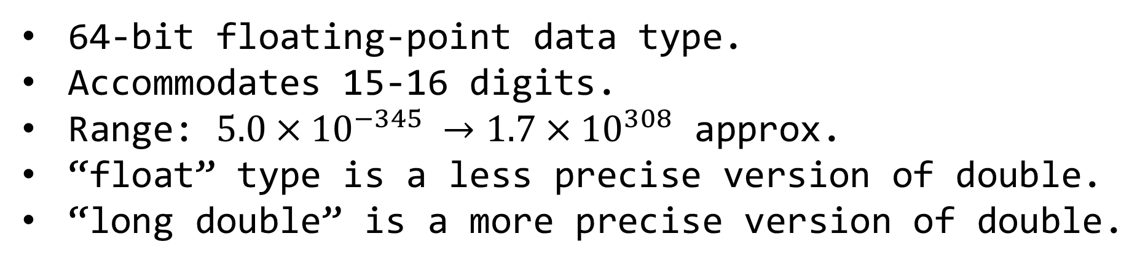
double
64-bit floating-point data type.
Accommodates 15-16 digits.
Range: $5.0×{10}^{−345} →1.7×{10}^{308}$ approx.
“float” type is a less precise version of double.
“long double” is a more precise version of double.

Slide 12
bool
Stores only two values “true” and “false” .
True represents 1.
False represents 0.

Slide 13

Strings in C++
A sequence of characters.
Used to express words or sentences.
The value of a string must be written in a double quote like in : .
It is actually an array of characters (more on arrays later).
It has lots of nice properties which we will see later.
More on Strings can be found here.

Slide 14
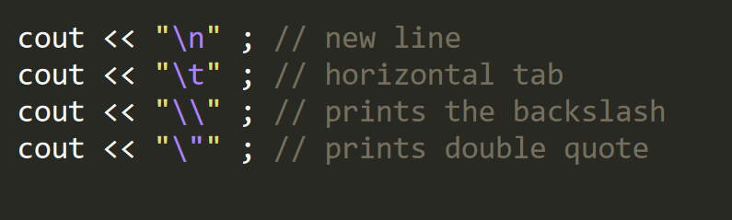
Special Characters
These characters do special tasks when printed.

Slide 15
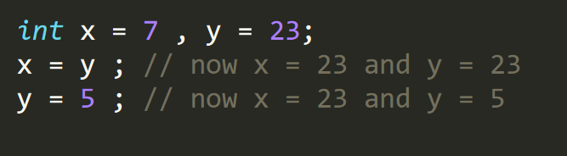
Assignment Operator
‘=’ : Used to assign values to variables.
Think of it as follows:
  Copy the value on the right.
  Paste it to the variable on the left.

Slide 16
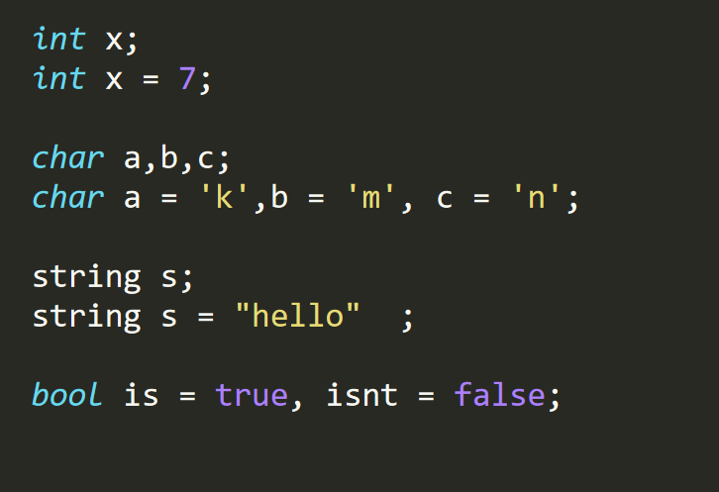
Variable declaration
Format: datatype variable_name ;
You can declare more than one variable
  in one line.

Slide 17
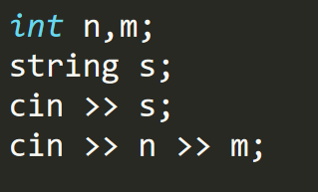
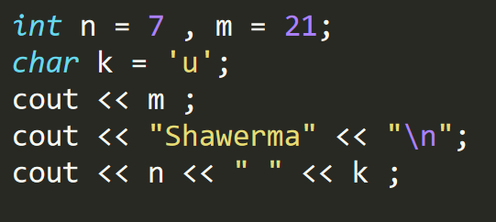
Input & Output
We can output values to the console using “cout” and the << operator.
We can input values from the user using “cin” and the >> operator.
More than one variable can be input/output on the same line.

Slide 18
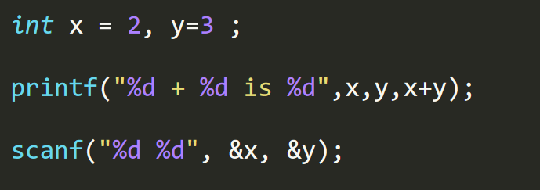
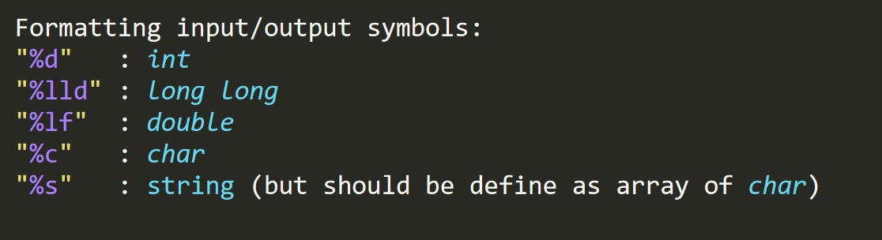
Fast Input and Output
These are the C
Language input and output, we will use them because the are fast.

Slide 19
Arithmetic
Operations supported
+ : addition.
- : subtraction.
* : multiplication.
/ : division.
% : modulo (remainder of division).

Slide 20
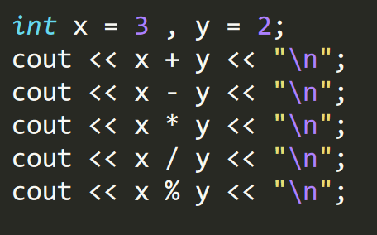
Example

Slide 21
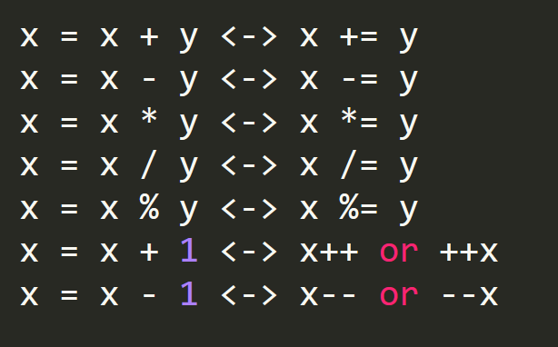
Arithmetic Shortcuts

Slide 22
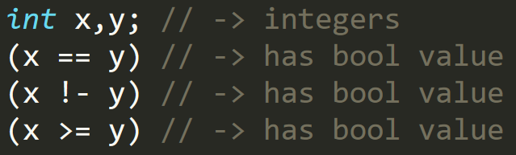
Boolean Expressions
Expressions that have value of type “bool”, either “true” or “false”.
The Boolean operators are :
  == , != : tests the equality of two variables
  >, <, >=, <= : just like in mathematical inequalities.
NOTE DO NOT CONFUSE == AND = .

Slide 23
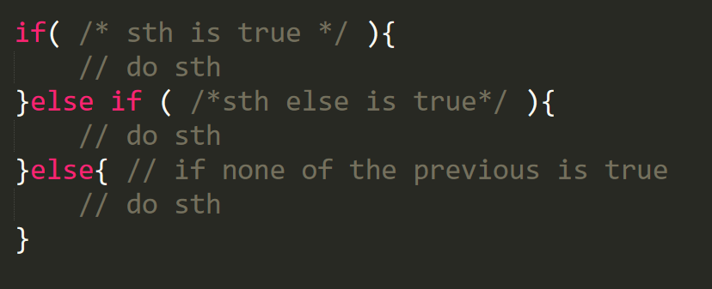
If statement
Format : if(Boolean_expression){do stuff}.
The body will execute only if the Boolean_expression’s value is true.

Slide 24
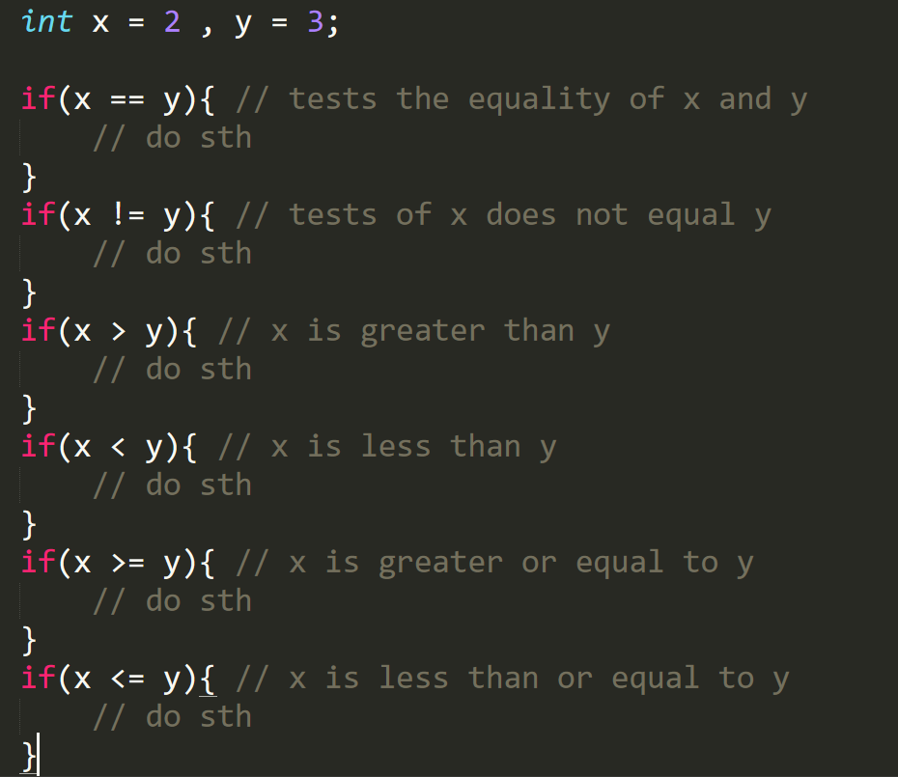
Example

Slide 25
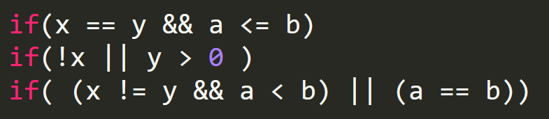
Logical Operators
We can combine Boolean expressions in if statement using the following operators:
  && : returns true if its two operands are true
  || : returns true if any of its operands is true
  ! : returns the opposite of the value

Slide 26
Loops
Used when we want to repeat a specific block of code, which actually will be the case in most of the programs we will write.
The loop keeps looping while a certain condition or Boolean expression is still true.

Slide 27
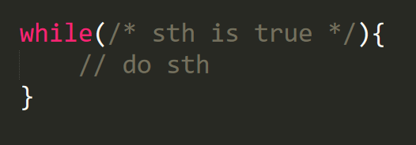
while loop
Keeps looping while the provided Boolean expression is true.
Checks the Boolean expression first, then if true executes the body.

Slide 28
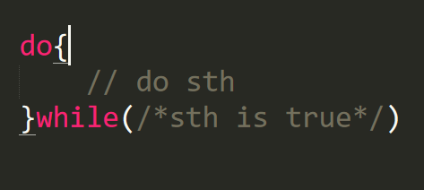
do while statement
Works the same way the while loop does, except for it executes then checks the Boolean expression and continues in case its value was true.

Slide 29

for loop
Format:
Any executable
Statement usually
increment is used
Initial conditions
Condition of
continuation

Slide 30
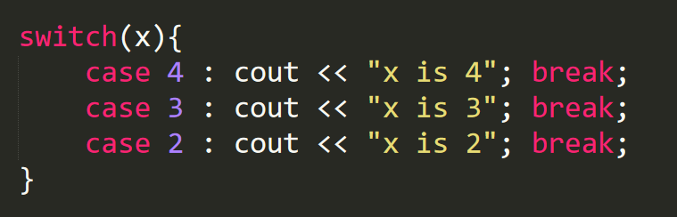
switch statement
The variable which we want to test its value
We should add break statement after each case
If the value of x matches any of the cases
It executes the commands after it
The commands to be executed

Slide 31
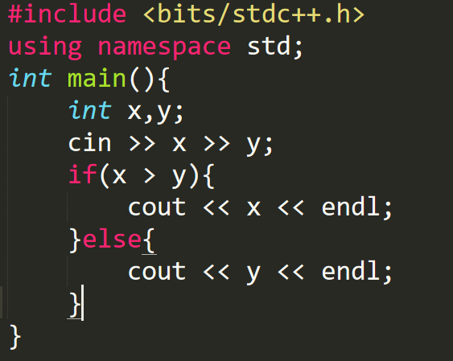
Example

Slide 32
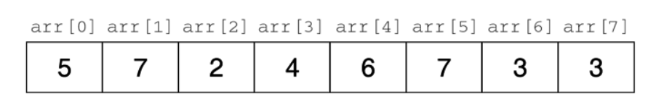
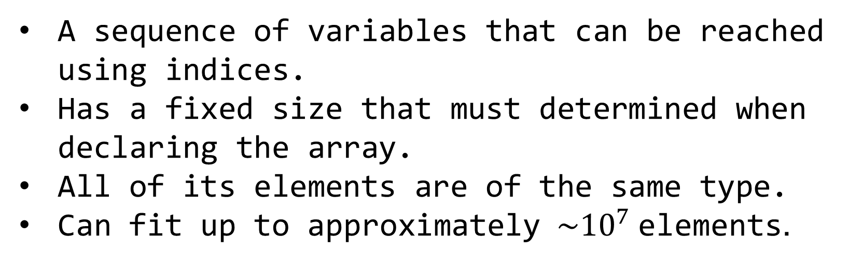
1D Arrays
A sequence of variables that can be reached using indices.
Has a fixed size that must determined when declaring the array.
All of its elements are of the same type.
Can fit up to approximately $\sim {10}^{7}$elements.

Slide 33
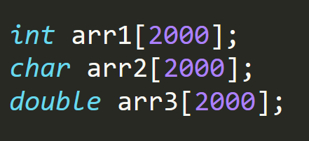
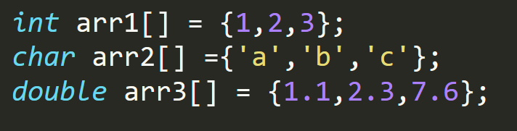
1D Arrays Format
Format : dataType arrayName[size] ;
We can also declare an array with initial values.

Slide 34
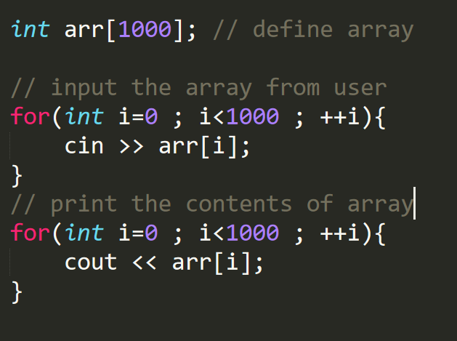
Example

Slide 35
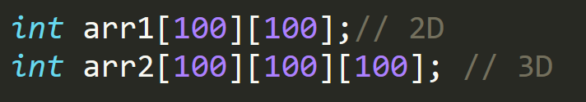
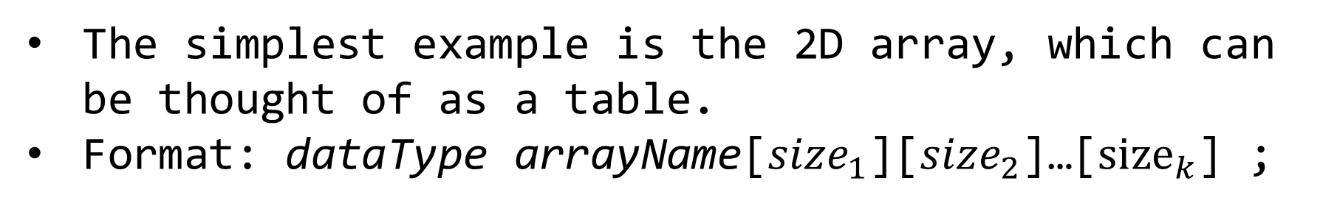
Multi-Dimensional Arrays
The simplest example is the 2D array, which can be thought of as a table.
Format: dataType arrayName[$size_{1}$][$size_{2}$]…[${size}_{k}$] ;

Slide 36
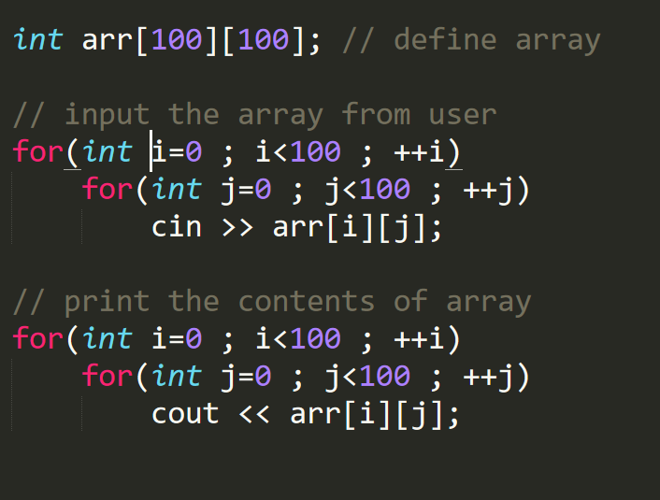
Multi-Dimensional Arrays
Example

Slide 37
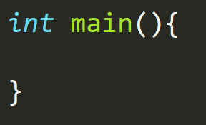
Functions
Remember the template ?
Let’s see what
this part does

Slide 38
Functions
Functions are blocks of code in which we can execute our commands.
Every C++ program must have at least 1 function
Everything in the main function will be executed.
We can write other functions that do certain tasks and call them whenever we like to help us.
Many tasks can be done without using functions, but sometimes they make the code shorter and clearer and are more intuitive to use.
How can we write a function ?

Slide 39
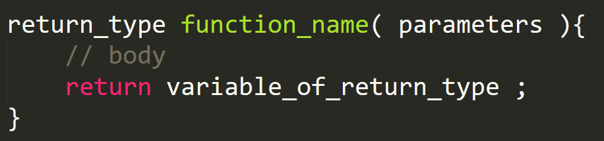
Functions
Format :
A function receives variables when called, and also returns a variable of a specified type.

Slide 40
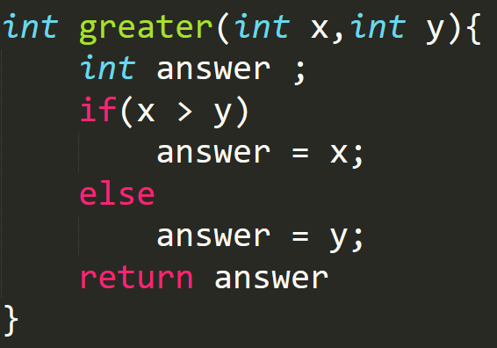
Example
A function that receives two integers and returns the one of greater value.

Slide 41
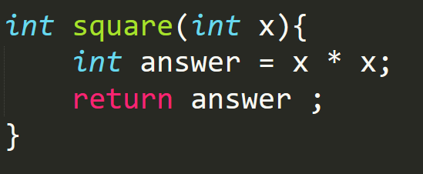
Example
A function that receives two integers and returns the one of greater value.

Slide 42
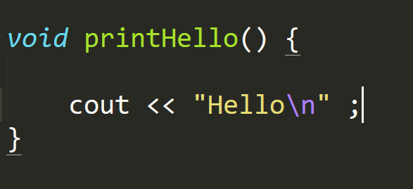
Functions
There can be functions that do not receive any parameters, as well as functions that do not return any value.
The return type of the function that does not return anything is “void”.

Slide 43
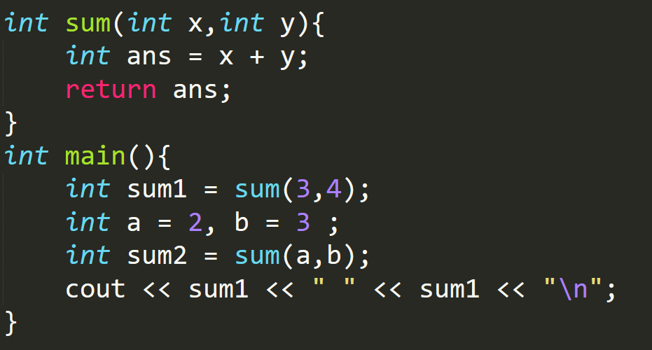
Calling Functions
We can call a function by writing its name with the parameters we want to send in parentheses.

Slide 44
Exercise
Write a program that takes two numbers as input from the user and prints the sum of their squares.
Write a program that takes a string and prints it backwards.

Slide 45
Further C++
Hackerrank C++ for Competitive Programming here.
CommonLounge C++ for Competitive Programming here.
Slides Prepared By Nazir Nayal

